Slide 1


Slide 2

VIT
Topic/Course
Sub-Topic (Example: name of college)

Slide 3

Image interpretation 1.1

Slide 4

Image interpretation 1.1
The Image interpretation is the process of analyzing visual information and being able to solve problems based upon it.
A person's image interpretation abilities are related to overall intelligence.
It is a component of nonverbal intelligence, meaning that a person does not have to use language in order to solve visual problems.
It measures fluid intelligence which is your ability to quickly identify patterns, logical rules and trends in new data, identifying causes, integrate this information, and apply it to solve problems.

Slide 5
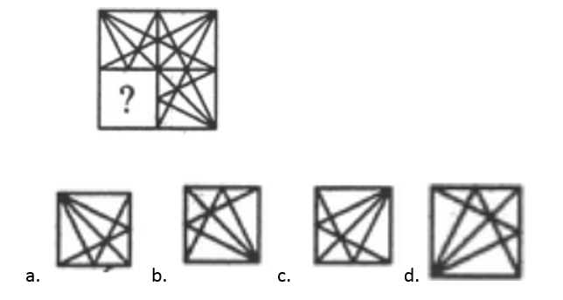
Question 1
In the following question, select a figure amongst the four alternatives, which when placed in the blank space of figure (?) would complete the pattern.
Notes:
Answer: D
Image: View->Notes page
Only option 4 completes the pattern.

Slide 6
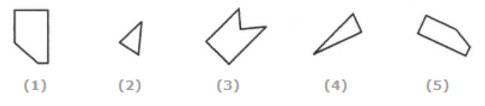
Question 2
In the following question, a set of five figures 1, 2, 3, 4 and 5 is given. It is required to select the option which represents three out of the five given figures which when fitted into each other would form a complete square.
A)
124
B)
125
C)
234
D)
245
Notes:
Answer: B
Image: View->Notes page
In the given alternatives, 1,2 & 5 are fitted appropriately to form a square.

Slide 7
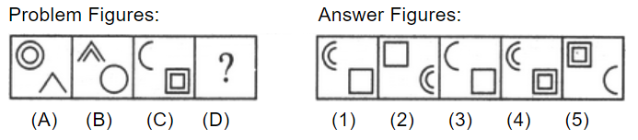
Question 3
The following question consists of two sets of figures. Figures A, B, C and D constitute the Problem Set while figures 1, 2, 3, 4 and 5 constitute the Answer Set. There is a definite relationship between figures A and B. Establish a similar relationship between figures C and D by selecting a suitable figure from the Answer Set that would replace the question mark (?) in fig. (D).

Slide 8
Question 3
A)
1
B)
2
C)
3
D)
4
E)
5
Notes:
Answer: B
Each one of the upper elements is replaced by an element similar to the lower element(s) and each one of the lower elements is replaced by an element similar to the upper element(s). Moreover, the number of lines in upper and lower elements should remain the same. Figure 2 is a suitable option.

Slide 9
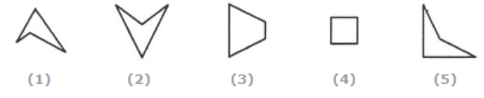
Question 4
In the following question, a set of five figures 1, 2, 3, 4 and 5 is given. It is required to select the option which represents three out of the five given figures which when fitted into each other would form a complete square.
A)
124
B)
345
C)
123
D)
135
Notes:
Answer: D
Image: View->Notes page

Slide 10
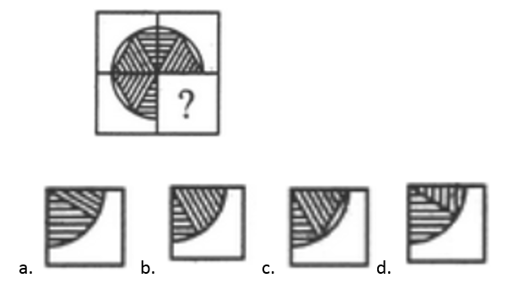
Question 5
In the following question, select a figure amongst the four alternatives, which when placed in the blank space of figure (?) would complete the pattern.
Notes:
Answer: C
Image: View->Notes page

Slide 11
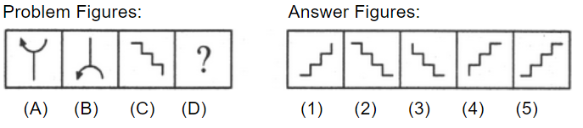
Question 6
The following question consists of two sets of figures. Figures A, B, C and D constitute the Problem Set while figures 1, 2, 3, 4 and 5 constitute the Answer Set. There is a definite relationship between figures A and B. Establish a similar relationship between figures C and D by selecting a suitable figure from the Answer Set that would replace the question mark (?) in fig. (D).

Slide 12
Question 6
A)
1
B)
2
C)
3
D)
4
E)
5
Notes:
Answer: A
The figure gets vertically inverted.

Slide 13
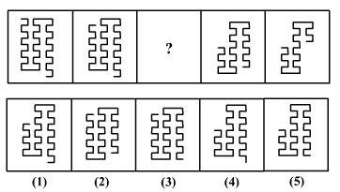
Question 7
Directions for questions:
Given below are two sets of figures, the ‘Problem Figures’ and the ‘Answer Figures’ marked 1, 2, 3, 4 and 5. Which figure from 1, 2, 3, 4 and 5 should be in place of the question mark to continue the series?

Slide 14
Question 7
A)
1
B)
3
C)
2
D)
4
E)
5
Notes:
Answer: C
Between the first and second frame, 2 lines get deleted from the left hand side.
Between the fourth and fifth frame, 8 lines get deleted from the right hand side. Here, we see that the pattern is not consistent throughout. This implies that the pattern alternates between frames.
Hence, between frames 2 and 3, some lines should get deleted from the right hand side while between frames 3 and 4, some lines should get deleted from the left hand side. Then number of lines deleted in each frame should be 2,4,6,8. Hence, if we delete 4 lines from the right hand side between frames 2 and 3, we get option 2.

Slide 15
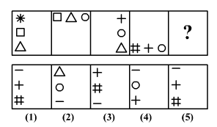
Question 8
The following question consists of two sets of figures. Figures A, B, C and D constitute the Problem Set while figures 1, 2, 3, 4 and 5 constitute the Answer Set. There is a definite relationship between the given figures. Establish a similar relationship the final figure and the answer figure by selecting a suitable figure from the Answer Set that would replace the question mark (?).

Slide 16
Question 8
A)
1
B)
2
C)
3
D)
4
E)
5
Notes:
Answer: C
In frame 1,the figure(square) in the middle goes to the last(square) in frame 2.The middle(circle) figure in frame 3 becomes last figure in frame 4(circle).Similarly the middle figure in frame 4 should be the last figure in the answer frame. Only option 3 satisfies this.
Comparing the figures it is changing in clockwise direction and form one fig to another exactly 2 shapes retained and 1 shape changes. So ans must be 3

Slide 17
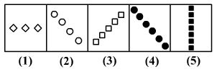
Question 9
Find the odd one out.
A)
1
B)
3
C)
2
D)
4
E)
5
Notes:
Answer: D
It is moving in clockwise direction which should complete 1 rotation Further the 4th pattern must be horizontal so 4th figure is the odd man out

Slide 18
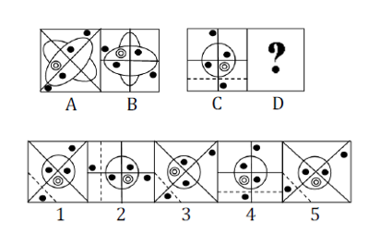
Question 10
The second figure(B) in the problem figures bears a certain relationship to the first figure(A). Similarly, one of the figures in answer figures(1,2,3,4,5) bears the same relationship to the fourth figure(D). You have to select the figure from the set of answer figures which would replace the sign of the question mark (?)

Slide 19
Question 10
A)
3
B)
2
C)
5
D)
1
E)
4
Notes:
Answer: C
By observing the question figure, The eclipse in the box has tilted 45 degree right. Hence the same change is observed for circle. Hence 5 is the correct answer.

Slide 20
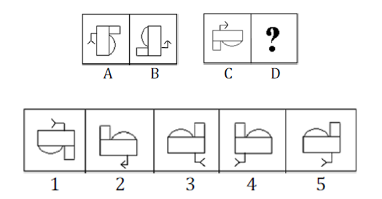
Question 11
The second figure(B) in the problem figures bears a certain relationship to the first figure(A). Similarly, one of the figures in answer figures(1,2,3,4,5) bears the same relationship to the fourth figure(D). You have to select the figure from the set of answer figures which would replace the sign of the question mark (?)

Slide 21
Question 11
A)
3
B)
2
C)
5
D)
1
E)
4
Notes:
Answer: A
By observing the question figure, it is a mirror image for the question and tilted downwards. The same change is to observed for the question. Hence 3 is the correct answer.

Slide 22
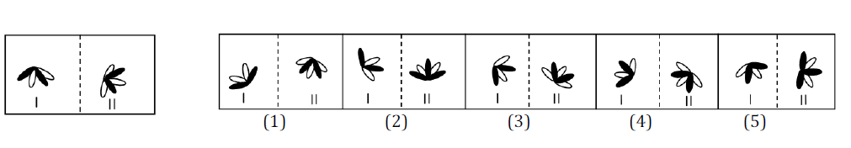
Question 12
In the following question, a related pair of figures is followed by five numbered parts of figures. Select the pair that has a relationship similar to that in the original pair. The best possible answer is to be selected from a group of fairly close choices.

Slide 23
Question 12
A)
3
B)
2
C)
5
D)
1
E)
4
Notes:
Answer: A
In the question figure the shaded leaf has rotated anticlockwise 30 degree between leaves. Now searching for the similar pattern, the answer is 3

Slide 24
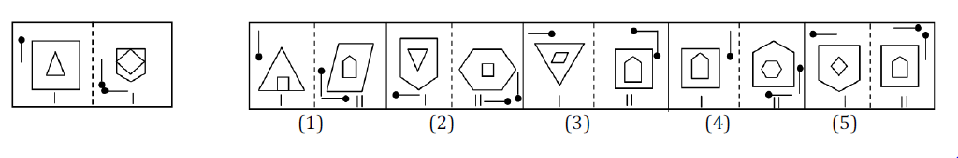
Question 13
In the following question, a related pair of figures is followed by five numbered parts of figures. Select the pair that has a relationship similar to that in the original pair. The best possible answer is to be selected from a group of fairly close choices.

Slide 25
Question 13
A)
3
B)
2
C)
5
D)
1
E)
4
Notes:
Answer: B
Following the direction of the arrows option 2 is correct.

Slide 26
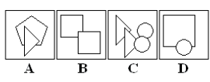
Question 14
Which figure is the odd one out?
A)
A
B)
B
C)
C
D)
D
Notes:
Answer: D
Consider a circle as having one "side" as it does not have end-points.
Question Figure A: Pentagon + Triangle. Total sides = 5+3 = 8
Question Figure B: 2 squares. Total sides = 4+4 = 8
Question Figure C: 2 Triangles + 2 circles. Total sides = 3+3+1+1 = 8
Question Figure D: 1 square + 1 circle. Total sides = 4+1 = 5
Hence, figure D is the incorrect member

Slide 27
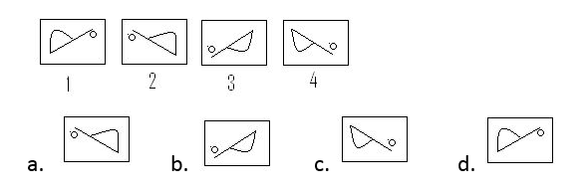
Question 15
Find the next image:
Notes:
Answer: D
Figure 2 is the mirror image of Figure 1
Figure 3 is the water image of Figure 2
Figure 4 is the mirror image of Figure 3
So there is an alternating pattern of mirror images and water images of the previous figure, which is followed.
Hence, Figure 5 has to be the water image of Figure 4.
Hence, figure 4 is the answer.

Slide 28
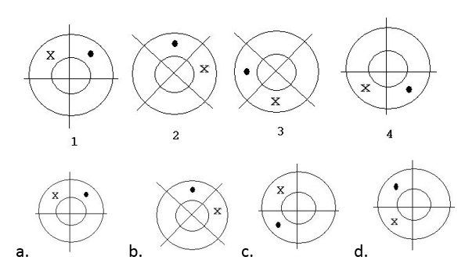
Question 16
Find the next image:
Notes:
Answer: D
Image: View-> Notes page
The black dot moves in the anti-clockwise manner as below: From Figure 1 to Figure 2 : 45 degrees. From Figure 2 to Figure 3 : 90 degrees. From Figure 3 to Figure 4 : 135 degrees. From Figure 4 to Figure 5 : it should be 135+45 = 180 degrees. The ’X’ moves as follows: In Figure 1: It is to the left of the black dot. In Figure 2: It is to the right to the black dot. In Figure 3: It is to the left of the black dot. In Figure 4: It is to the right of the black dot. In Figure 5: It should be to the left of the black dot. Hence, the answer is (diag.)

Slide 29
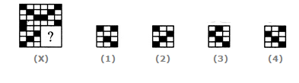
Question 17
Identify the figure that completes the pattern
A)
1
B)
2
C)
3
D)
4
Notes:
Answer: D
Image: View->Notes page
The answer can be the either figure 1 or 4, because the pattern shows the mirror image of the next to the image. So the figure 4 is the answer because, that figure only follows the diagonal pattern in the figure. Hence the final answer is

Slide 30
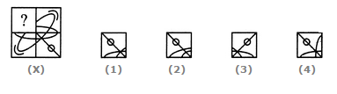
Question 18
Identify the figure that completes the pattern
A)
1
B)
2
C)
3
D)
4
Notes:
Answer: A
Image: View->Notes page

Slide 31
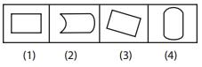
Question 19
Find the odd man out.
A)
1
B)
2
C)
3
D)
4
Notes:
Answer: D
Opposite side of every image faces same direction except figure 4.

Slide 32
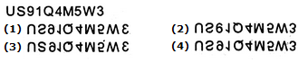
Question 20
Choose the alternative which closely resembles the water-image of the given combination.
A)
1
B)
2
C)
3
D)
4
Notes:
Answer: D
The fourth alternative is the correct answer. Because it is the exact mirror image of the statement.

Slide 33

THANK YOU

